Slide 1
Department of Computer Science & Engineering
UE17CS355 – Web Tech II Laboratory
Project Evaluation
Project Title : Stock Exchange
Project Team : PES1201700970 – Amrita Shivananda Hegde
PES1201701370 – Chaitra H P
PES1201701742 – Bhanu Priya C G

Slide 2
Project Description
Stock Mania is basically a stock exchange website which gives the information about NSE and NASDAQ.
From the Home page user can register or login to become the member of Stock mania. Guest user can always get access to the content. The user authentication part is done in Django with sqlite database.
If the user want to get the information about particular NSE listed company, he can get the auto complete feature there ( submission throttling) and get the equity, opening price, closing price, total trading quantity, total trading volume, isin.
When the user want to know the realtime stock prices, he can search for the company and get the near real time value. We implemented this by periodic refresh. Value gets updated in every 2 seconds.
We have the feature for prediction of future stock rates with good accuracy.

Slide 3


Technologies Used
Flask
Django
jQuery
Bootstrap
MySQL
SQLite

Slide 4
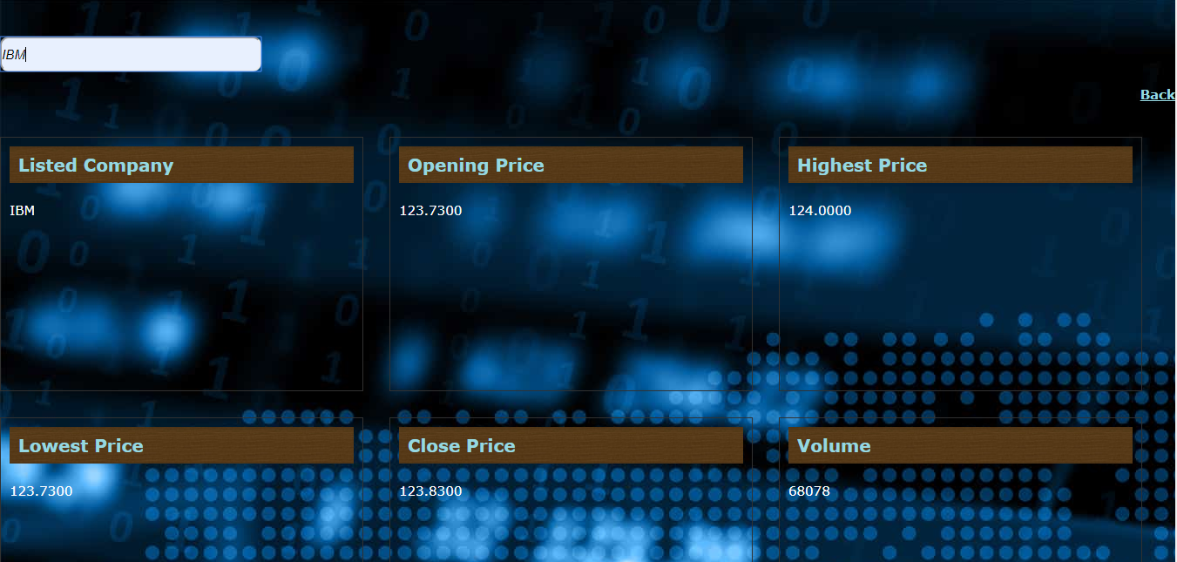
Techniques Implemented
Submission Throttling.
Submission throttling for dynamic company search-bar for retrieving listed company names by substring matching.
Periodic Refresh.
Periodic refresh for getting near real time stock prices from NSE stock api without actually refreshing the page,

Slide 5
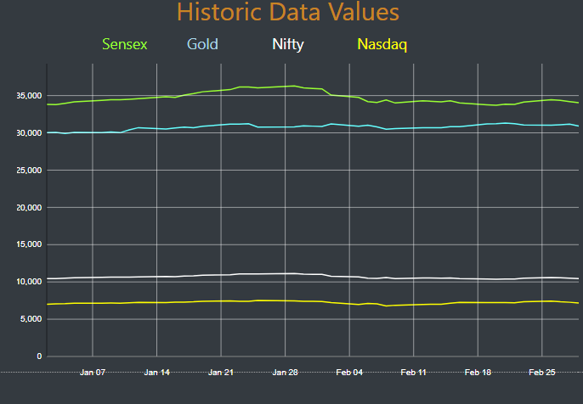
Intelligent Functionality
Regression:
Implemented machine learning predicting model using regression. Scrapes the historical data and predicts based on that data. For the given interval of time it plots the graph and analyzes it. Predicts the future stock prices with good accuracy.

Slide 6
Thank You

